Slide 1

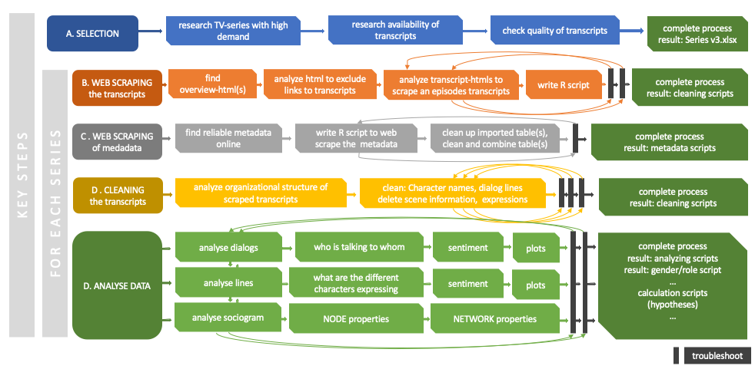




Gender biases in animated series for children – a network analysis
Table 1: Augen- und Haarfarbenkombination von 592 Statistik-StudentInnen.
Haar-\Augenfarbe | Braun | Blau | Grau | Grün | Summe
Braun | 119 | 84 | 54 | 29 | 286
Blond | 7 | 94 | 10 | 16 | 127
Schwarz | 68 | 20 | 15 | 5 | 108
Rot | 26 | 17 | 14 | 14 | 71
Summe | 220 | 215 | 93 | 64 | 592
Martin Faschingbauer^{1*}, Supervisor: Guilherme Wood¹
¹University of Graz
Introduction
In Albert Banduras Social-Cognitive-Theory children are learning social behaviour mostlythrough observation of others and the social consequences associated with it. These implications are also true when children are observing behaviour through a television program [3,5].
The occurrence of gender biases in mass media, especially in television have been well documented over
the last decades throughout different fields of research.
Gender stereotypes are widely spread in media in general, as well as in TV shows for children. Often male characters outnumber female characters by 2:1 [1], they appear on screen more often, speak more words, ask more questions and have more questions directed towards them compared to female characters [4].
Figure 1: Processing workflow incl. step descriptions and respective workflow results
Study Aim: The aim of this explorative research study was to investigate the occurrence of gender specific properties in popular animated series by analysing the related transcripts using computational manners.*
Methods
Sample: 131 open-source transcripts of the animated series ”Miraculous: Tales of Ladybug & Cat Noir“ by Zagtoon, 27 unrepresentative transcripts excluded.
Processing and calculation: After web-scrapping the data and a complex cleaning process, textlines sentiment analyses were computed using sentiment.ai. Graph-characteristics were used to examine social properties within the series. Furthermore two-way ANOVAs and χ²-tests were used for hypotheses testing (Table 1)
The steps of transcript processing are shown in detail in Figure 1. Computations were conduced exclusively using R by CRAN.
Figure 1: Processing workflow incl. step descriptions and respective workflow results.
Figure 1: Processing workflow incl. step descriptions and respective workflow results
Results & Discussion
text
Header 66, Text 44
[2] study Baker, K., & Raney, A. A. (2007)
Haar-\Augenfarbe | Braun | Blau | Grau | Grün | Summe
Braun | 119 | 84 | 54 | 29 | 286
Blond | 7 | 94 | 10 | 16 | 127
Schwarz | 68 | 20 | 15 | 5 | 108
Rot | 26 | 17 | 14 | 14 | 71
Summe | 220 | 215 | 93 | 64 | 592
Table 1: Hypotheses.
Hypothesis | Research Question
H1 | A difference in the sentiments of characters' expressions depending on their gender as well as that of the recipient is expected.
H2 | It is expected that the following text parameters will differ depending on the gender of the character and that of the recipient: - number of speech prompts - number of words spoken - number of questions asked (sending/receiving) - ergänzen
H3 | Centrality of Main characters to others by gender (Betweeness) betweenness, top 10 – gender
Conclusion & Limitations
Nur eine serie
Transcript quality,
Labeling of character characteristics based on web-research
References [1] Aubrey, J. S., & Harrison, K. (2004). The Gender-Role Content of Children's Favorite Television Programs and Its Links to Their Gender-Related Perceptions. Media Psychology, 6(2), 111–146. https://doi.org/10.1207/s1532785xmep0602_1 [2] Baker, K., & Raney, A. A. (2007). Equally super?: Gender-role stereotyping of superheroes in children’s animated programs. Mass Communication & Society, 10(1), 25-41. DOI: 10.1080/15205430709337003 [3] Bandura, A. (1965). Influence of models' reinforcement contingencies on the acquisition of imitative responses. Journal of Personality and Social Psychology, 1(6), 589–595. https://doi.org/10.1037/h0022070 [4] Biddle, A. M. (2017). Gender Stereotypes within TV shows for Preschoolers and their Effects on Children's Stereotypes, ProQuest Dissertations Publishing. http://hdl.handle.net/10125/62738 [5] Bussey, K., & Bandura, A. (1999). Social cognitive theory of gender development and differentiation. Psychological Review, 106, 676-713.
*Corresponding author: martin.faschingbauer@edu.uni-graz.at, psychology.uni-graz.at
Notes:
Introduction
*Or :The purpose of this exploratory study was to investigate the occurrence of gender-specific traits in popular animated series by analysing the corresponding transcripts using computational techniques.

